Slide 1
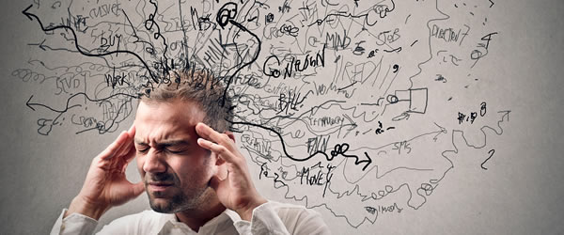
Understanding foreign language learner anxiety
Dr Christina Gkonou
Department of Language and Linguistics
University of Essex, UK
cgkono@essex.ac.uk

Slide 2
Workshop outline
What anxiety is
1
How anxiety impacts on learning
2
How we can research anxiety
3

Slide 3
Some facts about anxiety
Social anxiety typically begins around age 13.
Specific phobias begin around age 7.
General anxiety disorders estimated to affect up to 5% of the UK population.
(Source: NHS)

Slide 4
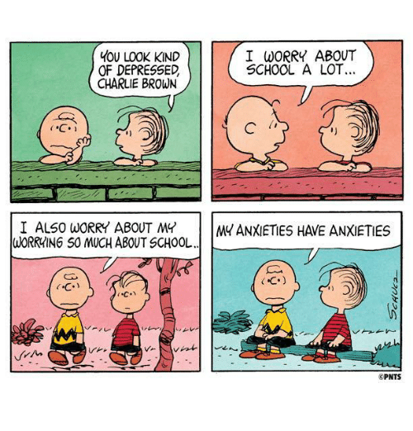
Potential fallout of anxiety

Slide 5
Have you ever heard these comments?

Slide 6
“I sweat every time I have to speak English with a native speaker.”
“I hate speaking English in front of the class.”
“My heart starts beating faster every time my teacher asks me a question.”
“I am ashamed of speaking English because of my accent.”
“I always feel that other students are more at ease to speak than me.”
(Adapted from the Foreign Language Classroom Anxiety Scale; Horwitz et al., 1986)

Slide 7
Language anxiety
“…the worry and negative emotional reaction when learning and using a second language and is especially relevant in a classroom where self-expression takes place.” (Gregersen & MacIntyre, 2014: 3)
Relatively common, but largely unwelcome emotion, because it can impact negatively on the language learning experience.

Slide 8
Language anxiety
Conceptually similar to three performance-related anxieties:
Communication apprehension
Fear of negative evaluation
Test anxiety
However, communication apprehension + fear of negative evaluation + test anxiety ≠ language anxiety (Horwitz, 2017).

Slide 9
Boon or burden?
Anxiety is primarily negative and hinders learning; debilitative anxiety (Gkonou, Daubney, & Dewaele, 2017).
Some anxiety can ‘push’ people to work = incentive, drive, tension, alertness; facilitative anxiety (Williams, Mercer, & Ryan, 2015).

Slide 10
Yerkes-Dodson Law

Slide 11
trait vs.(?) state anxiety
Trait anxiety: personality-related and task-independent
State anxiety: environment-triggered and task-dependent
Susceptible to environmental threats? Or own dispositional vulnerability? Or both?

Slide 12
Research has shown that…
Personality traits (e.g. neuroticism, introversion) as significant predictors of language anxiety (Dewaele 2002, 2013; Dewaele & Al-Saraj, 2015).
Recent idiodynamic view of language anxiety and emotions: tendency to fluctuate over time (Gregersen, MacIntyre, & Meza 2014; MacIntyre & Gregersen, 2012).
Language anxiety encompasses both aspects of the trait (i.e. stable) and state (i.e. dynamic) dichotomy in classrooms ⇨ complexity of the construct.

Slide 13
Causes
Self-degrading thoughts: excessive self-evaluation, fear of failure, concern over others’ opinions.
Social comparisons/peer pressure, desire for teachers’ approval.
Error correction, underestimate one’s abilities.
Language testing: abilities taxed because of demands of test (on top of…).
Specific tasks.
Specific skills.

Slide 14
Consequences
Behavioural/physical Increased heartbeat, tension, trembling Fidgeting, less eye contact | Linguistic/cognitive Proficiency and achievement Forgetting what has been learned
Emotional Insecurity, panic, worry, embarrassment Procrastination, perfectionism | Interactional/social Less participation, silence Limit social exchanges

Slide 15
Consequences
Abandoning studies;
Negative attitudes towards the target language;
Low willingness to communicate;
Tensions among learners;
Self-doubts;
Stifling learners’ enthusiasm and motivation.
(Gkonou, Daubney, & Dewaele, 2017)

Slide 16
Studying anxiety
Self-reports
Questionnaires (e.g. FLCAS; Horwitz et al., 1986)
(in-depth) interviews
Classroom observations + stimulated-recall interviews
But more excitingly…
Scenario-based tools: Managing Your Emotions for language learning (MYE; Gkonou & Oxford, 2016)

Slide 17
An example from MYE
Scenario 1: The teacher assigns an essay writing task in class and allows 60 minutes for completion of the task. After a couple of minutes, you notice that your classmates have already started writing while you still work on the outline of your essay.
What kind of emotions would you experience in this situation? (Circle the appropriate letter.)
Positive
Negative
Please name the emotions (one or more) you would feel in this situation. (maximum 10 words)

Slide 18
What would you do in order to manage these emotions in this situation? (maximum 50 words)
What would you do to increase any positive emotions in this situation? | What would you to do handle any negative emotions in this situation?

Slide 19
An example from MYE
Have you ever encountered this situation or something like it? (Circle the appropriate letter.)
Yes
No
If the answer to #4 is yes (that is, you encountered this situation or something like it before), and if your teacher helped you, circle the appropriate letter below.
My teacher (current or past) tried to teach me how to manage my emotions in this situation, and it was successful.
My teacher tried to teach me how to manage my emotions in this situation, but it was not successful.
If your teacher tried to teach you to manage your emotions in this situation, how did he or she teach you to do this? (maximum 30 words)

Slide 20
An example from MYE
If the answer to #4 is yes (that is, you encountered this situation or something like it before), and if you did not have help from a teacher, circle the appropriate letter below.
I consciously tried to manage my emotions in this situation, and it was successful.
I consciously tried to manage my emotions in this situation, but it was not successful.
I was not conscious enough of my emotions in the situation and therefore could not manage my emotions.
If you tried to manage your emotions in this situation, how did you do so? (maximum 30 words)

Slide 21
More examples of scenarios
Scenario 2: You make a mistake during a classroom oral activity. Your teacher corrects you in front of the class.
Scenario 3: You make a mistake during a classroom oral activity. One of your classmates corrects you in front of the class.
Scenario 7: Your teacher divides the class into groups of four. The task is to create a poster on the topic of bilingualism and present it to the rest of the class at the end of the week. You do not know one of the group members very well (i.e. you have never spoken outside class).

Slide 22
Conclusion
Language learner anxiety is multidimensional.
Research could help towards identifying the nature of anxiety.
Language learning as an enjoyable and lifelong experience!

Slide 23
Please feel free to get in touch via email:
cgkono@essex.ac.uk

