Slide 1
Exploratory Practice: Integrating Research and Pedagogy in EAP
Dr Judith Hanks
Webinar for IATEFL ReSIG
28 February 2018

Slide 2
A starting point
What is the Webinar about?
Pedagogy in EAP
Research in EAP
Integrating the two (scholarship) in EAP
Epistemological and practical challenges
How can I find the article?
Hanks, J. (2017b). Integrating research and pedagogy: an Exploratory Practice approach. System, 68, 38-49.

Slide 3
EP is process-oriented (Breen, 2006)
puzzling
exploring practice(s) together
developing understanding(s)

Slide 4
Integrating Research and Pedagogy…
Exploratory Practice: based on a framework of principles encompassing Quality of Life, Working for Understanding, Collegiality, Sustainability and “Principle 7: Minimise the burden by integrating the work for understanding into normal pedagogic practice” (Allwright & Hanks, 2009: 260)
But what might this mean in EAP practice?

Slide 5
English for Academic Purposes Pedagogy
EAP – a special form of language teaching
It aims to prepare students for their chosen academic careers by
bringing together the academic skills and genres required to engage in the chosen academic community
enhancing linguistic resources (command of the language itself, and, crucially, critical thinking expressed in forms recognisable to the chosen academic community)

Slide 6
Pre-sessional programmes
Typically in the UK this is done via ‘Pre-sessional programmes’ which cover aspects such as academic writing in different genres (reports, case studies, essays), critical reading/listening, and oral presentations of student work.
“Such activities are part of the fabric of EAP practice […] Yet the potential of these every-day activities for research remains largely untapped.” (Hanks, 2017b: 40)
Pre-sessionals may be short (4, 6 or 10 weeks), or they may be long (1-2 years)
There are also in-sessional support programmes, …but that’s another story for another day

Slide 7
EAP Projects
Many pre-sessional programmes require students to engage in small-scale research projects investigating issues such as ‘Water Wars’ or ‘Malaria’. In addition to reading, they gather, then collate and analyse data. They present their findings via oral presentations, posters, and written reports or essays.
NB: This is not to endorse any particular view of EAP teaching, but merely to describe the situation at the time of the case study presented here.

Slide 8
Integrating research and pedagogy Case study 1
My situation:
a very intensive 10-week pre-sessional course teaching English for Academic Purposes (EAP)
84 students from all over the world
7 teachers
Goal oriented; high stakes; limited time span
Participants:
The teachers: John and Kay
The learners (Cheer, Meow, Kae, Gina, Ken, Lynne)
Names chosen by the participants (pseudonyms) are used

Slide 9
Case Study 1: weaving EP into EAP
Teachers and students worked together to identify what puzzled them about their language learning experiences
They wove this into the pre-existing project work so that the focus of investigations was the puzzling generated by the students
They shared control of the classes with the students (Allwright, 2005; Freire, 1973) in a form of ‘inquiry as stance’ (Cochran-Smith & Lytle, 2009). This in turn led to scholarship (Shulman, 2000) and further research (see Hanks, Forthcoming).

Slide 10
What about the learners?
Meow: ‘I think it's very helpful for - for me if I can understand er what puzzle I have. And I- I just find 'Oh! I have a lot of puzzle that I never thought about it before!”’
Kae: ‘It's fantastic because this er... we don't usually think about this kind of question so... [laughs] I don't know I will ... I don't know whether I will find the answer of the ques- of the puzzlement, my puzzlement, but it's exciting’

Slide 11
Would you like to try it?
John: I’d be really interested but I think it would turn into a hugely time-consuming thing […] I’m just thinking of time. I’m thinking of… is this going to be like umm a 10,000 word essay, or a 5,000 word essay, I mean what- what have I got to produce?
[…] I think they will react well because they will see that this is a skill they need to start to develop because they will need it.
Kay: Do you think that by doing this this way we’re going to be honing the analytical and critical skills of the students?

Slide 12
The case study: EP in EAP
What we did:
4 weeks of the 10-week course included an EP strand
3 weeks of preparation (Puzzling-Investigations-More Puzzling): 2-3 classes per week
4th week led up to poster presentations by the learners for the learners and their teachers
Follow-up work (writing)

Slide 13
Practising key academic skills

Slide 14
Relevance
John: … today when I asked them about 10 minutes before the period ended to “close everything down now and come and sit in your seats”, they didn’t come!
(( Why?))
They were so involved I don’t think they registered that I’d asked them. […]

Slide 15
Learner puzzles
Judith: so what’s your puzzle?
Meow: why can’t I use English well after studying for a long time?
[laughter]
Cheer: [clearly and distinctly] it’s exactly same as me!

Slide 16
John: they're negotiating everything. [...] they're also discussing what information should be in, go into the report or go onto the project, how it should be shown, what sort of a chart, ... on how they're going to talk

Slide 17
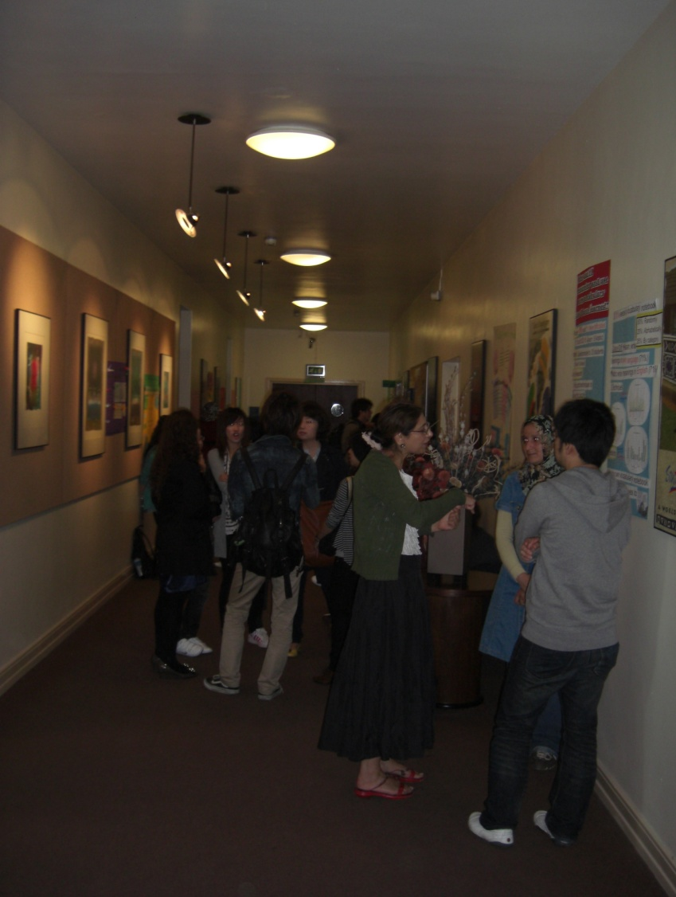
The poster presentations (after 4 weeks)

Slide 18
Sharing puzzles, sharing understandings
Kae: it is interesting to […] show my thinking to others and if the others, and they will be excited the problem, yes I'm hap-happy, yeah

Slide 19
Why can’t I concentrate…?

Slide 20
What did the students think?
Lynne: very helpful, I think, because if just in class the teacher said something, and we just accept some answer, I think it’s easy to forget it.
Every student take part in this process and we found the answer by ourselves.

Slide 21
Reflecting on EP
John: the vast majority of them… hadn’t solved anything. But they had learnt more.
it’s given them an excellent speaking and writing opportunity
they can see it’s entirely relevant […] to what they’re going to be doing

Slide 22
John: It’s a gentle way into heavyweight research […]
I see it as a tool, as a springboard for jumping into more and more formal research

Slide 23
What about ‘the academy’?
Traditionalists in EAP seem unaware of movements in the Higher Education Academy
Inquiry-based learning
Research-based teaching
“actively engaging students with research suitably adapted to recognise the variation and complexity of constructing knowledge in different disciplines, is one way of re-linking them in the twenty-first century” (Healey, 2005: 73-4)

Slide 24
Case study 2: an EAP teacher developing her scholarship
A teacher becomes interested in Exploratory Practice because her colleague is engaging in field work for her PhD… She volunteers to join in…
A: I’m not really going to be doing much of it I suppose so I’m kind of… frustrated (laughs)
[…]
J: there’d be nothing to stop you researching your own puzzle yourself […] if you wanted…
A: … yeah… I think it’s making, making the time, isn’t it?
(Interview 1a, week 1)

Slide 25
From puzzling alone to sharing puzzlement
A: [EP] is motivating me to do it rather than making me... […] I suppose [EP] is making me think about ways I could make time, if I do find that I’ve got time, it’s what I will do
(Interview 2a, week 4)
A: and then the plan is that at some point over the summer I do a bit more reading about it, perhaps develop some materials for a workshop. I mean, X came to see me about it…
(Interview 3a, week 10)

Slide 26
Sustainable Scholarship and Research
After the pre-sessional finished, Teacher A did indeed spend the summer investigating her puzzle further, and in the autumn she ran a Teacher Development workshop for colleagues.
A year later, she presented her work at the annual BALEAP national conference in the UK.
Following that, she wrote up her work for the Conference Proceedings publication.
She has gone on to disseminate her EP work through presentations and publications at international as well as national levels.

Slide 27
Mentors and ‘femtors’
Although I was a mentor for Teacher A over several years, mentoring her in different aspects of her work (not only Exploratory Practice, but other areas too), I feel it is significant that as she grew in confidence, and developed her own authorial voice, I was able to step back.
In fact, in her most recent piece of work, I’m delighted to say that Teacher A did not involve me at all
Teacher A has also, in recent years, mentored me in aspects of my work.
An example of ‘femtoring’??? The EP principle of ‘mutual development’?

Slide 28
Exploratory Practice in Language Teaching (Hanks, 2017a)

Slide 29
Epistemological and Practical Challenges
Does Exploratory Practice provide a ‘way in’ to the academic community for practitioners?
Is Exploratory Practice just about language?
Are these examples just about surface level study skills and language learning?
Is Exploratory Practice presenting a view of decontextualised language and skills practice?
How does all this translate into research and scholarship in a discipline?

Slide 30
“… the compulsively bureaucratic ‘measuring culture cultivated over the last thirty years in UK (and other) education structures. As a result, buzzwords like quality assurance, evidence of learning, benchmarking, SMART targets, accountability, outcomes assessment and performance indicators have become the norm. EAP, it must be conceded, fits neatly into this culture as it remains largely pragmatic. […]
In prioritising quality of life in the classroom, and […] reclaiming the human element of education, EP seems to me the ideal antidote to what some refer to as EAP’s ‘vulgar pragmatism’ (Pennycook, 1997) which focuses on delivering the aforementioned outcomes at the cost of reflective, critical pedagogy.”
(Cliff Kast, IATEFL ReSIG on-line discussion, 25 Feb 2018)

Slide 31
Critical questions
Does this ‘count’ as
research?
scholarship?
something else?
What counts?
Who gets to decide what counts?
EP critically questions people’s assumed hierarchies and power relationships… It is therefore deliberately disconcerting

Slide 32
Concluding remarks
The principles of Exploratory Practice speak to agendas of scholarship, inquiry-based learning, research-based teaching, and fully inclusive practitioner research.
Arguably, EP in these case studies worked well not despite the goal-oriented intensity of EAP, but because it was directly relevant to student and teacher needs.
What is needed now is for the power-brokers of EAP to acknowledge the affordances of Exploratory Practice for the field. A paradigm shift??

Slide 33
Where can practitioners publish their work?
IATEFL Research Special Interest Group (ReSIG)
http://resig.weebly.com/
http://resig.weebly.com/teachers-engaging-in-research.html
ELT Researchhttp://resig.weebly.com/newsletter.html
TESOL Academic
http://www.tesolacademic.org/
http://www.tesolacademic.org/researchpapers.htm

Slide 34
Could learners as well as teachers publish?
Learner Development Working Papershttp://ldworkingpapers.wixsite.com/ld-working-papers (See particularly Chapter 8 by Stewart et al.)
Learner Development Journalhttps://ldjournalsite.wordpress.com/
Teachers Research Festival:https://trfestival.wordpress.com/events/

Slide 35
Could learners, students and teachers publish their work in more creative ways?
Sousanis, N. (2015) Unflattening.
Hillary Place Papershttps://hpp.education.leeds.ac.uk/
The Language Scholarhttps://languagescholar.leeds.ac.uk/
International Student Experience Journal
http://isejournal.weebly.com/

Slide 36
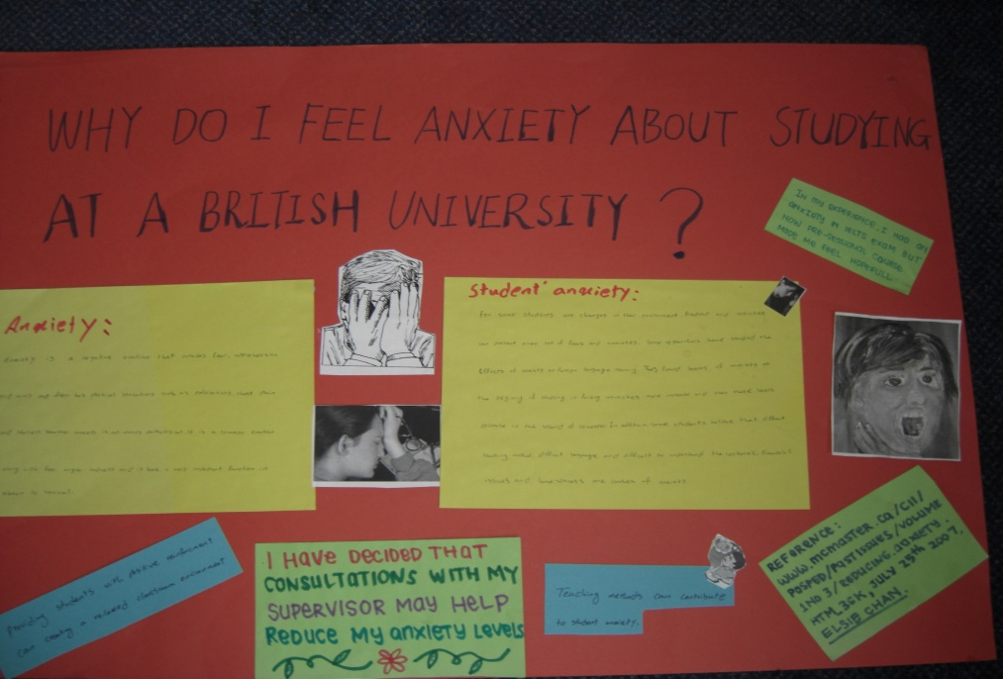
Thank you!
Judith Hanks
j.i.hanks@leeds.ac.uk

Slide 37
References
Allwright, D. (1993). Integrating 'research' and 'pedagogy': Appropriate criteria and practical possibilities. In J. Edge & K. Richards (Eds.), Teachers Develop Teachers Research (pp. 125-135). Oxford: Heinemann.
Allwright, D. (2005). Developing principles for practitioner research: The case of Exploratory Practice. The Modern Language Journal, 89(3), 353-366.
Allwright, D., & Hanks, J. (2009). The Developing Language Learner: An introduction to Exploratory Practice. Basingstoke: Palgrave Macmillan.
Banister, C. (Forthcoming). ‘Rebuilding practitioner self-efficacy through learner feedback.’ In A. Slimani-Rolls and R. Kiely, Exploratory Practice: An innovative form of continuous professional development, Palgrave Macmillan.
Best, K., Jones-Katz, L., Smolarek, B., Stolzenburg, M., & Williamson, D. (2015). Listening to our students: An Exploratory Practice study of ESL writing students’ views of feedback. TESOL Journal (6)2, 332-357.
Bond, B. (2016). The E(A)P of Spelling: using exploratory practice to (re)engage teachers and students. BALEAP 2016 Conference Proceedings. Garnet Education.
Breen, M.P. (2006). Collegial development in ELT: The interface between global processes and local understandings. In S. Gieve & I.K. Miller (Eds.), Understanding the Language Classroom (pp. 200-225). Basingstoke: Palgrave Macmillan.
Cochran-Smith, M. & Lytle, S.L. (2009). Inquiry as Stance: Practitioner research for the next generation. New York: Teachers College Press.
Costantino, A. (Forthcoming). Understanding ‘Local’ Pedagogy: a written feedback puzzle. In A. Slimani-Rolls & R. Kiely, Exploratory Practice for Continuing Professional Development: An innovative approach for language teachers. Palgrave Macmillan.

Slide 38
References (continued)
Crane, C., Sadler, M., Ha, J.A. & Ojiambo, P. (2013) Beyond the methods course: using exploratory practice for graduate student teacher development. In H.W. Allen & H. Maxim (Eds.), Educating the Future Foreign Language Professoriate for the 21st Century (pp.107-127). Boston: Heinle.
Dalsky, D. & Garant, M. (2016). A 5,000 mile virtual collaboration. IN A. Tajino, T. Stewart, & D. Dalsky (Eds.). (2016). Team teaching and team learning in the language classroom: Collaboration for innovation in ELT (pp. 164-178). Abingdon, Oxon: Routledge.
Dar, Y. (2015) Exploratory Practice: Investigating my own classroom pedagogy. In D. Bullock and R. Smith (Eds.) Teachers Research! (pp.51-59). Faversham: IATEFL. [online]: http://resig.weebly.com/uploads/2/6/3/6/26368747/teachers_research_.pdf
Doğdu, B. & Arca, D. (Forthcoming). Why do students consider integrated skills lessons as a grammar and vocabulary lesson? In K. Dikilitaş & J. Hanks (Eds.). Developing Language Teachers with Exploratory Practice: Innovations and explorations in language education: Palgrave Macmillan.
Freire, P. (1973). Education for Critical Consciousness. New York: Seabury Press.
Gieve, S., & Miller, I.K. (2006a). What do we mean by 'Quality of Classroom Life'? In S. Gieve & I.K. Miller (Eds.), Understanding the Language Classroom (pp. 18-46). Basingstoke: Palgrave Macmillan.
Goral, M. (Forthcoming) Exploratory Practice: Embracing New Identities. In A. Slimani-Rolls & R. Kiely, Exploratory Practice for Continuing Professional Development: An innovative approach for language teachers. Palgrave Macmillan.
Gunn, C. (2003). Exploring second language communicative competence. Language Teaching Research, 7(2), 240-258.

Slide 39
References (continued)
Hanks, J. (2015a). 'Education is not just teaching': Learner thoughts on Exploratory Practice. ELT Journal, 69(2), 117-128. (First published online: December 1, 2014)
Hanks, J. (2015b). Language teachers making sense of Exploratory Practice Language Teaching Research, 19(5), 612-633.
Hanks, J. (2017a) Exploratory Practice in Language Teaching: Puzzling about principles and practices. London: Palgrave Macmillan.
Hanks, J. (2017b). Integrating research and pedagogy: an Exploratory Practice approach. System, 68, 38-49.
Hanks, J. (Forthcoming) From Research-as-Practice to Exploratory Practice-as-Research in Language Teaching and Beyond. Language Teaching.
Healey, M. (2005). Linking research and teaching: exploring disciplinary spaces and the role of inquiry-based learning. In Barnett, R. (Ed.), Reshaping the University: New relationships between research, scholarship and teaching. (pp67-78). Maidenhead: Open University Press.
Healey, M., Flint, A. & Harrington, K. (2014) Engagement through partnership: students as partners in learning and teaching in higher education. York: EH Academy.
Iedema, R., Mesman, J. & Carroll, K. (2013) Visualising Health Care Practice Improvement. London: Radcliffe Publishing Ltd.
Kahneman, D. (2012) Thinking, Fast and Slow. UK: Penguin Random House UK.

Slide 40
References (continued)
Karanfil, T. (Forthcoming). Investigating and understanding 'free reading' experiences through Exploratory Practice. K. Dikilitaş & J. Hanks (Eds.). Developing Language Teachers with Exploratory Practice: Innovations and explorations in language education. Palgrave Macmillan.
Kramsch, C. (2009). The Multilingual Subject. Oxford: Oxford University Press.
Kuhn, T.S. (1962/1996). The Structure of Scientific Revolutions (3rd ed.). Chicago: The University of Chicago Press.
Li, N. (2006) Researching and experiencing motivation: a plea for 'balanced research'. Language Teaching Research, 10(4), 437-456.
Mumford, S. (Forthcoming) Understanding the challenges of academic presentations for EAP students: an Exploratory Practice approach. K. Dikilitaş & J. Hanks (Eds.). Developing Language Teachers with Exploratory Practice: Innovations and explorations in language education: Palgrave Macmillan.
Perpignan, H. (2003). Exploring the written feedback dialogue: A research, learning and teaching practice. Language Teaching Research, 7(2), 159-278.
Pinner, R. (2016). Trouble in Paradise: Self-assessment and the Tao. Language Teaching Research 20(2), 181-195.
Rowland, L. (2011). Lessons about learning: Comparing learner experiences with language research. Language Teaching Research, 15(2) 254-267
Shulman, L.S. (1986). Those who understand: Knowledge growth in teaching. Educational Researcher 15(2), 4-14.
Shulman, L.S. (2000). From Minsk to Pinsk: Why a scholarship of learning and teaching? Journal of Scholarship of Learning and Teaching 1(1), 48-53.

Slide 41
References (continued)
Smith, C. (2009). Developing a new English for academic purposes course: Administrator-teacher-student collaboration. In T. Yoshida, H. Imai, Y. Nakata, A. Tajino, O. Takeuchi & K. Tamai (Eds.), Researching Language Teaching and Learning: An integration of practice and theory (pp. 95-113). Bern: Peter Lang.
Sousanis, N. (2015). Unflattening. Cambridge, MA: Harvard University Press.
Stewart, A., with Croker, R. & Hanks, J. (2014). Exploring the principles of Exploratory Practice: Quality of Life or Quality of Learning? In A. Barfield & A. Minematsu (Eds.), Learner development working papers: Different cases: Different interests. (pp. 132-148) Tokyo: JALT Learner Development SIG http://ldworkingpapers.wix.com/ld-working-papers
Tajino, A., & Smith, C. (2005). ‘Exploratory practice and soft systems methodology.’ Language Teaching Research, 9(4), 448-69.
Webb, R. & Sarina, T. (Forthcoming). The role of Exploratory Practice and international collaboration in creating a democratic classroom. In K. Dikilitaş & J. Hanks (Eds.). Developing Language Teachers with Exploratory Practice: Innovations and explorations in language education: Palgrave Macmillan.
Zhang, R. (2004). Using the principles of Exploratory Practice to guide group work in an extensive reading class in China. Language Teaching Research, 8(3), 331-345.
Zheng, C. (2012). Understanding the learning process of peer feedback activity: An ethnographic study of Exploratory Practice. Language Teaching Research, 16(1), 109-126.

