Slide 1
Africa TESOL / IATEFL Research SIG teacher-research initiative
Webinar 3: Data Analysis
Dr. Siân Etherington,
University of Salford, UK
s.etherington@salford.ac.uk

Slide 2
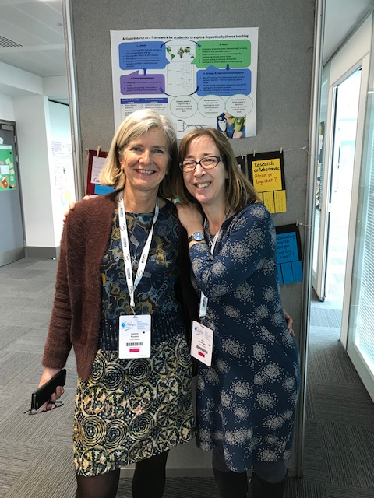
Hello and welcome!
Siân at ReSIG Pre-conference Event, IATEFL conference, Liverpool,
April 2019

Slide 3
Plan for today
This webinar will help participants to:
Consider data analysis approaches for Quantitative and Qualitative data
Analyze and present key aspects of Quantitative data
Begin to code qualitative data and explore themes
Consider alternative, creative approaches to data analysis and display

Slide 4
2 Questions to begin…
How much data collection have you done so far?
What kind of data have you collected?
E.g. 2 interviews with colleagues
25 student questionnaires
Notes:
POLL question

Slide 5
Different types of data
What sort of data are you collecting?
Notes:
Remember this from the previous webinar? Data which is about perceptions – your own or other peoples or about behaviour.
Which sort of data have you collected? Are you collecting?
Poll question

Slide 6
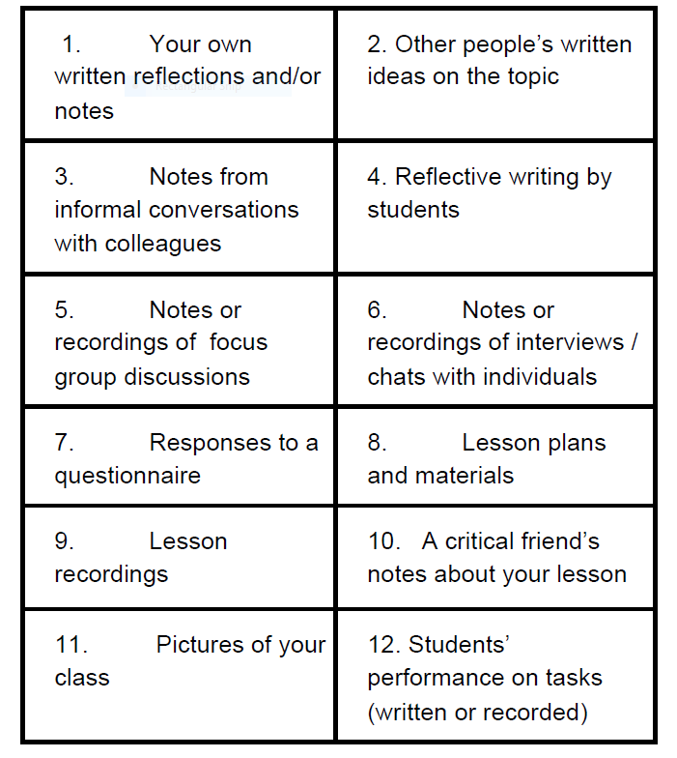
What kind of data?
Quantitative
or
Qualitative ?
What kind of data is each box?
Notes:
POLL question – Decide which kind of data each type is – put Quant or Qual with a number.
1= Qual 2= qual 3= ??

Slide 7
Quantitative ?
or
Qualitative ?
Or both?
QUALT
QUALT
QUALT
QUALT
QUALT
QUALT
QUANT
EITHER?
QUALT
EITHER?
QUANT
QUALT
Notes:
Not hard and fast –
Quantitative – Numbers
Qualitative – Words / Images
Observational or lesson material data – can be dealt with quantitatively – how many times ? Or qualitatively – what happened when… ?

Slide 8
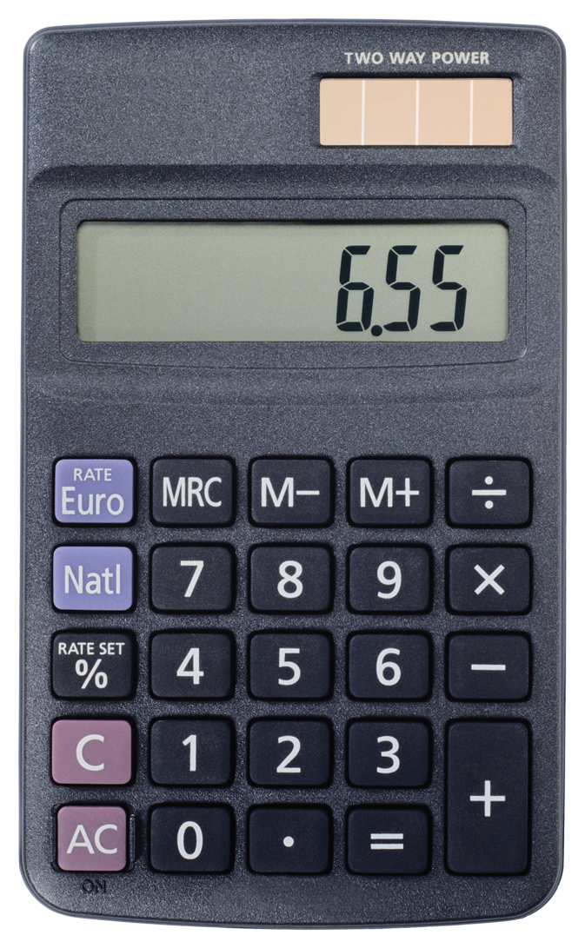


Different types of data
Quantitative
Qualitative
Numbers
Text / words (spoken or written)
Images
This Photo by Unknown Author is licensed under CC BY-SA
This Photo by Unknown Author is licensed under CC BY-SA
Notes:
Difference is what you are going to do with it – measure/ count or describe / interpret
Can use text and count things in it.

Slide 9
Analysing Data
Analysing data =
Organise the data
Interpret the data

Slide 10
Analysing Data
Analysing data =
Organise the data (clean up, put in order, put in groups, look at patterns)
Interpret the data (decide what it means - ‘so what?’)

Slide 12
Notes:
Going to look mostly at these aspects today
MOVE INTO NEXT SLIDE – LOOKING AT DATA FROM QUESTIONNAIRES

Slide 13
Notes:
Research Questions about student engagement in listening tasks
Questionnaire to find out what they thought of the listening lessons
POLL
Which are the interesting responses in the table? Which ones would you highlight? What would you write about? Take couple of minutes to look at the data. What numbers would you focus on in reporting this?

Slide 14
Notes:
Which are the highest responses in the table?
How easy is it to see this?
Not that much??
Put into another format to allow it to be easier to compare numbers – what could you use?

Slide 15
Notes:
The same data from the top of the table in a chart.
This is clearer – able to see the differences between the responses more easily.
Distinct categories –
Can make in Excel or if using Survey monkey it does it automatically.

Slide 16
Organising quantitative data
Pie chart
Can see the relationship of data to whole
Be careful of colours!
Notes:
Again you can use Excel to produce these charts – or Survey Monkey will do them for you.
QUANT data – thinking about the best ways to show the data and how people can read it.

Slide 17
Organising and Analysing qualitative data
Interview data – transcribe from audio (selected parts)
Notes : identify key parts
Survey data: open ended items – collate answers
Reflections: identify key parts
Notes:
MOVING ONTO QUAL DATA – DIFFERENT TYPES AND GETTING IT READY FOR ANALYSIS
Transcription – can take a long time – focus on key parts – can use Dictate functions on some packages to help with this.
MOVE TO NEXT SLIDE – looking at open-ended questions in questionnaires/ surveys – how deal with these?

Slide 18
Open-ended questions from surveys
How do you feel about speaking in class?
Write your answer below.
____________________________________
____________________________________
____________________________________
(Koray Akyazı in Dikilitaş, Wyatt, Hanks and Bullock eds. 2016 )

Slide 19
Some answers: how can we organize?
‘If I have information about the topic, it’s easier to talk about’
Talking with friends I feel more comfortable
I feel anxious when speaking with friends because I don’t want to make a mistake
If I have knowledge about the topic I feel less nervous
Relaxed when speaking with friends
I feel anxious when giving a presentation in class
Notes:
6 answers
Which are the key words in each one?
POLL – write down the words you think are important for each answer

Slide 20
Some answers : Key words
A ‘If I have information about the topic, it’s easier to talk about’
B Talking with friends I feel more comfortable
C I feel anxious when speaking with friends because I don’t want to make a mistake
D If I have knowledge about the topic I feel less nervous
E Relaxed when speaking with friends
F I feel anxious when giving a presentation in class
Notes:
NOW -
How can we organise these to show similar ideas together?
POLL - Which ones are similar? Match letters into pairs

Slide 21
Some answers: which go together?
A ‘If I have information about the topic, it’s easier to talk about’
B Talking with friends I feel more comfortable
C I feel anxious when speaking with friends because I don’t want to make a mistake
D If I have knowledge about the topic I feel less nervous
E Relaxed when speaking with friends
F I feel anxious when giving a presentation in class
Notes:
6 answers
How can we organise these to show similar ideas together?
These ones – A and D; B and E; C and F

Slide 22
Some answers: which go together?
‘if I have information about the topic, it’s easier to talk about’
If I have knowledge about the topic I feel less nervous
Talking with friends I feel more comfortable
Relaxed when speaking with friends
I feel anxious when giving a presentation in class
I feel anxious when speaking with friends because I don’t want to make a mistake

Slide 23
Some answers: what THEMES ?
‘if I have information about the topic, it’s easier to talk about’
If I have knowledge about the topic I feel less nervous
Talking with friends I feel more comfortable
Relaxed when speaking with friends
I feel anxious when giving a presentation in class
I feel anxious when speaking with friends because I don’t want to make a mistake
Notes:
What ideas about themes for each pair – write ideas in POLL box

Slide 24
Some answers: what THEMES ?
‘if I have information about the topic, it’s easier to talk about’
If I have knowledge about the topic I feel less nervous
Talking with friends I feel more comfortable
Relaxed when speaking with friends
I feel anxious when giving a presentation in class
I feel anxious when speaking with friends because I don’t want to make a mistake
Content
Who I am talking to
Anxiety
Notes:
These are possible themes for each pair – other ideas are OK

Slide 25
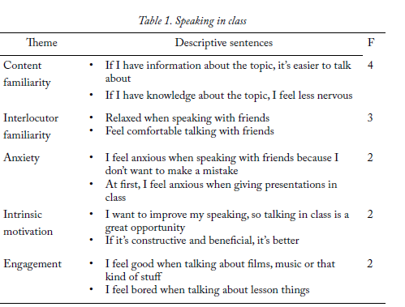
Notes:
This was final presentation of this data – with ‘fancier’ titles for the themes.
NEXT SLIDE – MOVING ONTO THINK ABOUT CODING LARGER PIECES OF QUALITATIVE DATA – TEXTS / REPORTS/ STORIES/ LONGER INTERVIEW PIECES

Slide 26
Text 1: The best teacher I’ve ever had (Moussa)
When I was in secondary school, in the 20s, I had many teachers who inspired me. I looked some of them like super heroes or extraordinary people. I couldn't believe with my young age that they were simple humans.
The one I admired more was our French teacher. He was so charismatic and kind. Everytime we had class with him the whole class was excited. We loved him with no limits. He used to say "Teaching is my job but school is not my office. It's my home with my sons, my daughter,... my friends". I kept all wise sayings he used to tell us.
He was the best teacher I ever had and if I am a teacher today, it's partly due to him.. He passed away years ago but I still have a thought to him.
Notes:
Thank you Moussa – and everyone else who submitted texts
This is text as it was written and emailed- READ IT OUT
What are we analysing it for? What is our research question? (what do TESOL Africa teachers think are characteristics of ‘the best teacher’ ever? – what do they value in teachers? )

Slide 27
Divide into ‘data chunks’ and key ideas
When I was in secondary school, in the 20s, I had many teachers who inspired me.
I looked some of them like super heroes or extraordinary people. I couldn't believe with my young age that they were simple humans.
The one I admired more was our French teacher. He was so charismatic and kind. Everytime we had class with him the whole class was excited. We loved him with no limits.
He used to say "Teaching is my job but school is not my office. It's my home with my sons, my daughter,... my friends". I kept all wise sayings he used to tell us.
He was the best teacher I ever had and if I am a teacher today, it's partly due to him..
He passed away years ago but I still have a thought to him.
Notes:
First piece of work is to divide into meaning units/ separate ‘ideas’ – words in bold are the ideas central to each part – the ‘chunks’

Slide 28
Coding key words in the text
Key word
When I was in secondary school, in the 20s, I had many teachers who inspired me.
I looked some of them like super heroes or extraordinary people. I couldn't believe with my young age that they were simple humans.
The one I admired more was our French teacher. He was so charismatic and kind. Everytime we had class with him the whole class was excited. We loved him with no limits. He used to say "Teaching is my job but school is not my office. It's my home with my sons, my daughter,... my friends". I kept all wise sayings he used to tell us.
He was the best teacher I ever had and if I am a teacher today, it's partly due to him.. He passed away years ago but I still have a thought to him.
Key word
Key word
Key word
Key word
Key word

Slide 29

Key words/ one word ‘codes’
Inspiring
Superhero
Charismatic
Kind
Exciting
Notes:
Single words in the text – representative of what ‘best teacher’ is like –
The words become ‘codes’ – move slightly – inspired moves to ‘inspiring’ / class was excited – exciting.
Picture to capture one of key ideas.

Slide 30
Coding ‘idea groups’:
When I was in secondary school, in the 20s, I had many teachers who inspired me.
I looked some of them like super heroes or extraordinary people. I couldn't believe with my young age that they were simple humans.
The one I admired more was our French teacher. He was so charismatic and kind. Everytime we had class with him the whole class was excited. We loved him with no limits. He used to say "Teaching is my job but school is not my office. It's my home with my sons, my daughter,... my friends". I kept all wise sayings he used to tell us.
He was the best teacher I ever had and if I am a teacher today, it's partly due to him.. He passed away years ago but I still have a thought to him.
Thinks of school as home and family
Inspired me to be a teacher
I still think about him/her
Notes:
Bigger than one word – ideas that seem important to the central question –
Here – best teachers – see school as a home / family
Best teachers have inspired other teachers
Best teachers are still thought about many years later.

Slide 31
Growing a list of codes: ‘Best teachers’ are…
Inspiring
Superhero
Charismatic
Kind
Exciting
Think of School as family
Inspire others to become teachers
Remembered for a long time
Notes:
Single words in the text – representative of what ‘best teacher’ is like –
The words become ‘codes’ – move slightly – inspired moves to ‘inspiring’ / class was excited – exciting.

Slide 32
Codes using informants’ own language/ phrases:
When I was in secondary school, in the 20s, I had many teachers who inspired me.
I looked some of them like super heroes or extraordinary people. I couldn't believe with my young age that they were simple humans.
The one I admired more was our French teacher. He was so charismatic and kind. Everytime we had class with him the whole class was excited. We loved him with no limits. He used to say "Teaching is my job but school is not my office. It's my home with my sons, my daughter,... my friends". I kept all wise sayings he used to tell us.
He was the best teacher I ever had and if I am a teacher today, it's partly due to him.. He passed away years ago but I still have a thought to him.
In vivo coding
Notes:
Codes which are from the text
In vivo codes
Here from reported speech of the teacher

Slide 33
Growing a list of codes: ‘Best teachers’
Inspiring
Superhero
Charismatic
Kind
Exciting
Think of School as family
Inspire others to become teachers
Remembered for a long time
‘teaching is a job but school is not my office’
Notes:
Actual words are very powerful – this is a really nice way of capturing this sense that the best teachers go beyond ‘doing the job’

Slide 34
Rejoice Rethabile’s data: what does it add ?
The best teacher I ever had was not more knowledgeable than the other teachers, not richer than the others, not more handsome than the others. He was an ordinary teacher, but what placed him shoulders higher than the other teachers on my list was his caring nature.
I remember how pleasantly surprised I was when he called me by my name; this was unusual because many teachers never knew my name. I remember that he took the time to write comments in our books based on the tasks we wrote. The comments were not general ones, like, “good”, “well done”, etc. He wrote personalized comments that made you realize that he had read your piece of work.
In addition, my favourite teacher was enthusiastic about his work. He was always well prepared for lessons and he made us enjoy the subject. Years later when I became a teacher I promised myself that I would be a teacher like him. I’ve had other teachers over the years, but he still stands out as my best teacher ever.
Notes:
Thank you Rejoice!

Slide 35
Rejoice Rethabile’s data: what does it add ?
The best teacher I ever had was not more knowledgeable than the other teachers, not richer than the others, not more handsome than the others. He was an ordinary teacher, but what placed him shoulders higher than the other teachers on my list was his caring nature.
I remember how pleasantly surprised I was when he called me by my name; this was unusual because many teachers never knew my name. I remember that he took the time to write comments in our books based on the tasks we wrote. The comments were not general ones, like, “good”, “well done”, etc. He wrote personalized comments that made you realize that he had read your piece of work.
In addition, my favourite teacher was enthusiastic about his work. He was always well prepared for lessons and he made us enjoy the subject. Years later when I became a teacher I promised myself that I would be a teacher like him. I’ve had other teachers over the years, but he still stands out as my best teacher ever.
Notes:
Thank you Rejoice!

Slide 36
Growing a list of codes: ‘Best teachers’
Inspiring
Superhero
Charismatic
Kind- CARING
Exciting
Think of School as family
  Used my name
Personalized comments
Inspire others to become teachers
Remembered for a long time (more data)
‘teaching is a job but school is not my office’
Ordinary teacher vs ‘best teacher’
Notes:
Adds some additional ideas within existing codes – Kind includes Caring
Add some ‘sub-themes’ – Family – relationships – knows names
Could also look at x vs. y – ordinary teacher vs. outstanding teachers

Slide 37
How could you present these findings?
Mind map or Diagram
superheroes
The best teachers are
Kind caring
Inspiring charismatic
Inspire students to be teachers
Remembered for a long time

Slide 38
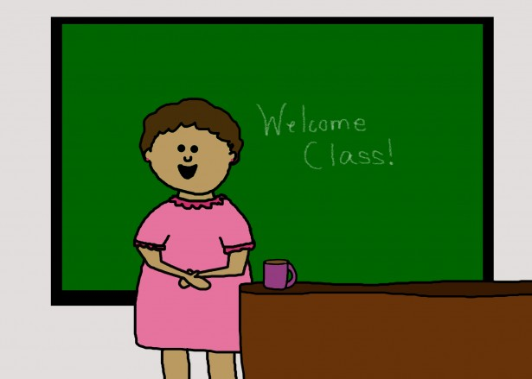
How could you present these findings?
Inspiring
Superhero
Charismatic
Kind
Exciting
Think of School as family
Inspire others to become teachers

Slide 39
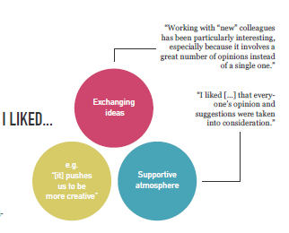
How did you find working with colleagues on writing?
Elena Ončevska Ager (2015)
Notes:
Combines themes and data extracts in nice model – (from Ager 2015 investigation of group writing approach and what students liked and didn’t like).

Slide 40
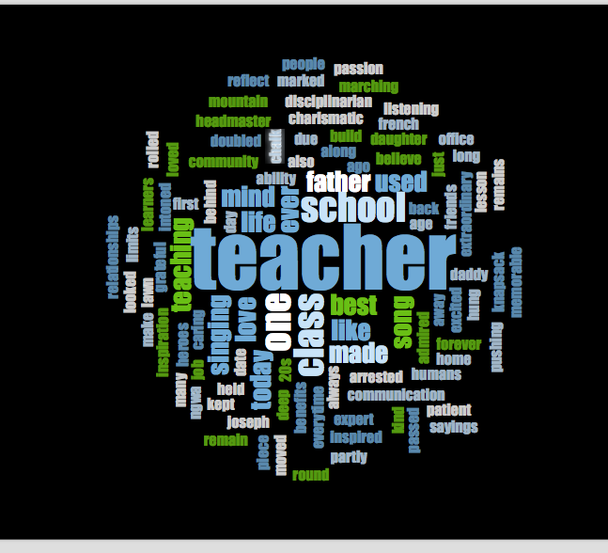
Word cloud of 3 ‘best teacher stories’
WordClouds.com.
WordArt.com.
Abcya.com.
Wordle.
TagCrowd.

Slide 41
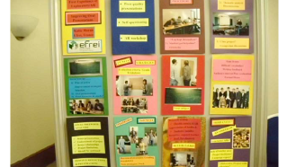
Other ways to present your data
Posters
Presentations
Pictures
Tell a story
Performances
Poems
http://resig.weebly.com/teachers-research.html
Notes:
Getting the ‘feel’ of your data
Keeping it ‘real’
Try not to lose sight of the original data
Performance: plays, stories, songs, poems
Who is your audience?
What do you want them to take away?

Slide 42
Useful resources
http://resig.weebly.com/teachers-research.html
And many others on the ReSIG weebly page

Slide 43
Closing words and reminders
No webinar now until January
Use the time well !
Get in touch with your mentor to update them on progress
Collect, analyze and start to interpret your data

Slide 44

Do you have any…
This Photo by Unknown Author is licensed under CC BY-SA

Slide 45

Finally….

