Slide 1
An investigation of The Short EAP course instructors' Views and Practices of ICT in Higher Education in the UK With The assistance of SAMR model.
By: Laila Farhat, MA TESOL
University of Warwick

Slide 2
Presentation plan
What is my research about ?
What is SAMR model ?
What sparked my interest ?
My research questions
Research plan
General discoveries
Questions

Slide 3
What is my research about ?
Instructors of short EAP courses’ use of ICT in the UK
Their rating of their use of ICT on SAMR model

Slide 4
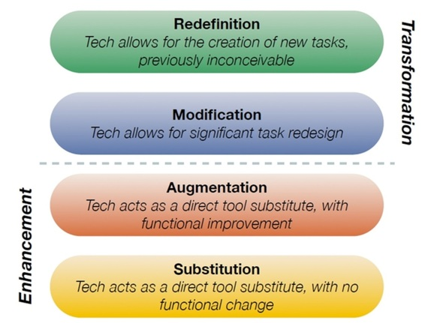
What is SAMR model ?
A framework that assists teachers in incorporating technology in their teaching.

Slide 5
What sparked my interest
01
02
Wanting to discover more about existing ICT
The simplicity of SAMR model
03
Pure interest in technology in teaching in EAP

Slide 6
What are my research question ?
What ICT tools do instructors of short EAP courses use in their teaching?
Why do they use these ICT tools in their teaching?
How do these teachers use these ICTs ?
What level of SAMR model would they put their use of some ICT tools on?
Why did they choose that level for that activity?

Slide 7
How I planned to answer my research questions
Interview with 4 instructors in the UK
Semi-structured
One Hour
Open ended question

Slide 8
How I analyzed my data
Transcribed interview
Printed the interview
Thematically analysed using highlighters

Slide 9
General discoveries
#1 Some common ICTs that my participants use/ have used in their teaching were Moodle, Teams, Word Document, Quizlet and Kahoot.

Slide 10
General discoveries
#2 One ICT tool can have multiple uses.
- Depends on teacher
- Example: referencing tools
Referencing tools
To teach referencing
To teach how not to reference

Slide 11
General discoveries
#3 One ICT tool can have different rating on SAMR model, depending on the teacher.
Quizlet
Augmentation
Substitution

Slide 12
General discoveries
#4 Similar environment = similar use of ICT tool

Slide 13
Reflection question for teachers: Am I using ICT in my teaching because it’s leading to better results, or am I using it for the sole purpose of using technology ?

Slide 14
Time for questions :)

Slide 15
Thank you
Have more questions?
Email me: Laila.Farhat@Warwick.ac.uk

