Slide 1
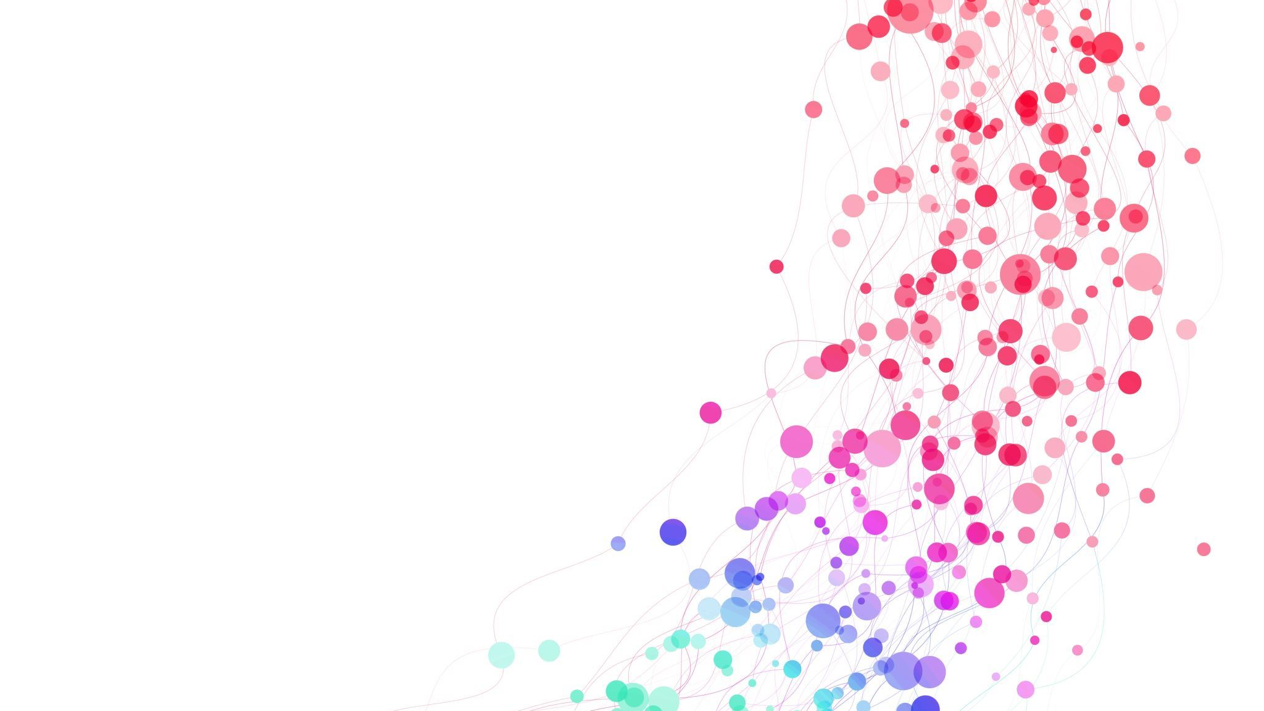
Adult EFLs/ESLs: A close examination into speaking anxiety in the classroom
Christina Work
University of Strathclyde

Slide 2
The Inspiration
'Enjoyment and Anxiety in Second Language Communication – An Idiodynamic Approach' - Boudreau, C., MacIntyre, P. D., Dewaele, J. M. (2018)
An article assigned for a presentation.
Examination into positive and negative emotions experienced by students learning French in Canada.
Emotions are severely ignored when it comes to Second Language Acquisition. Recommendation for further study.
X3842: Language Learning in a Multilingual World at the University of Strathclyde.
Module taught by Joanna McPake, part of MSc TESOL and Intercultural Communication.
Reflect and share our language learning experiences through online blog posts.
My peers and I shared similar struggles and emotions that were never supported.

Slide 3
Why this topic?
History should not repeat itself when there is an opportunity for innovation.
Adults may poessess more control of their life but that does not mean that anxiety does not affect them.
Language classes should be meeting the emotional needs of learners.
There is a significant gap in emotional research when it comes to adults.
Jean-Marc Dewaele's research has proven that emotions are crucial for language learning and teaching.
The idea of being a perfect 'native' is affecting learner motivation and manifesting anxiety.

Slide 4
Research Questions
What are the characteristics of students who suffer from second/foreign language speaking anxiety?
What are the sources of second/foreign language speaking anxiety?
Which strategies can be used to successfully cope with adult learners’ foreign language speaking anxiety?

Slide 5
Participant Profile
Characteristics | Number | %
Sex Male Female | 2 8 | 20 80
Age 18 – 20 21 – 30 31 – 40 41 – 50 | 0 4 6 0 | 0 40 60 0
Time Spent Learning English 1 – 2 years 3 – 4 years 5 – 6 years 6 + years | 0 0 0 10 | 0 0 0 100
University Degree MSc TESOL and Intercultural Communication MSc Education Studies | 8 2 | 80 20

Slide 6
Research Methods – An Action Research Study
An Interpretive Approach:
Examining human behaviour, individual motivations and reality perceptions.
Allows for simultaneous analysis to correct any flaws if required.
Mixed Methods Research:
The combination of qualitative and quantitative research.
Selective sampling of participants who meet criteria.
Online Data Collection:
Use of Microsoft Forms for Questionnaires.
Use of Zoom for online interview.
Data is stored securely and efficiently for analysis.

Slide 7
Data Collection Instruments
FOREIGN LANGUAGE CLASSROOM ANXIETY SCALE – HORWITZ, HORWITZ & COPE (1986)
33 Close-Ended Questions
Likert Scale
Quantitative Data
BIOGRAPHICAL SURVEY
13 Open and Close-Ended Questions
Participant Profile
Quantitative and Qualitative Data
INTROSPECTION INTERVIEW
24 Opened-Ended Questions
Self-Reflection
Qualitative Data
PERSONAL REPORT OF PUBLIC SPEAKING ANXIETY – MCCROSKEY (1970)
34 Close-Ended Questions
Likert Scale
Quantitative Data

Slide 8
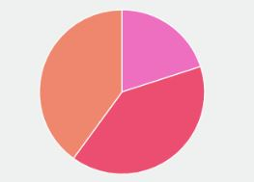
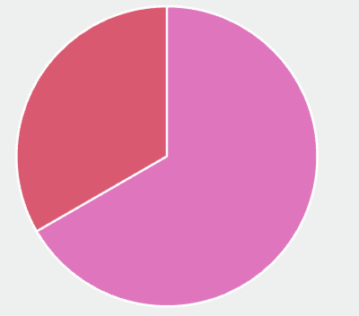
Findings – Quantitative Data
FLCAS RESULTS
PRPSA RESULTS
Levels of
Anxiety
In Adult
Learners
Very Low Moderately Low Moderate
Moderately High Very High
Low Medium High
10 Participants Completed
3 Participants Completed

Slide 9
Findings – Qualitative Data
"I feel that curriculums need to change to suit the emotional aspects of students and not just their academic abilities." - Participant A
"In India, speaking is something that has never been given enough importance, there are a lot of people that get hesitant when it comes to talking." - Participant C
"I would like my lecturer to be more supportive and understand my emotional needs." - Participant B

Slide 10
What are the characteristics of students who suffer from second/foreign language speaking anxiety?
Physical Traits:
Trembling of the body, rapid heartbeat and panic attacks.
Emotional Traits:
Worry, fear, memory lapse and self-doubt.
Avoidance of:
Class altogether, taking tests, speaking out and volunteering in class.

Slide 11
What are the sources of second/foreign language speaking anxiety?
Assessments:
Influence of assessment outcomes can negatively affect the student's ability to function and perform well.
Learning Content:
Students are more anxious with content they are unfamiliar with or do not understand. The fear of the "unknown".
Peer Pressure:
Pressure for adults exists in many forms; social acceptance, perform well academically and outside-the-classroom influences.
Interactions between student and teacher:
Teaching time is limited for adults due to the independence of their age group, and the responsibility to complete all the work individually.
Learning Environment:
Sense of competitiveness and determination to succeed despite the shared communities of practice that adult learners share.

Slide 12
Which strategies can be used to successfully cope with adult learners' foreign language speaking anxiety?
Time set aside for additional support/questions from students
Authentic/Modern materials to encourage interaction and relatability for students
Positive encouragement from lecturer/teacher
Regular and thorough feedback from lecturer/teacher to keep student on track
Simplified instructions and steady pace to ease confusion and worry
Increase enjoyment within the classroom to negate the negative effects of anxiety

Slide 13
Important Points
Even though the evidence of speaking anxiety in adults was low, there is evidence of foreign language classroom anxiety.
This study allowed the participants to voice their opinions and reflect on their learning experiences.
This study will serve as a foundation for further study into this area.

Slide 14
Conclusions
Learner age does not change the fact that students can experience negative emotions when it comes to their learning.
Adults may be more independent but that does not mean that they will not struggle in their studies.
Anxiety is one of the strongest negative emotions that can hinder a student's learning, especially in languages.

Slide 15
References
Boudreau et al. (2018). Enjoyment and anxiety in second language communication: An idiodynamic approach. Studies in Second Language Learning and Teaching, 8, 149 – 170
Dewaele, J. M. (2023, February, 20). Multilinguals’ language preference for communicating emotions. Host Site: UCL Mediacentral, URL: https://mediacentral.ucl.ac.uk/Play/94747
Gao, J. (2022). Scales assessing L2 speaking anxiety: development, validation, and application. Frontiers in Psychology, 13, 1 – 13
Horwitz, E. K., Horwitz, M. B., & Cope, J. (1986). Foreign language classroom anxiety. Modern Language Journal, 70(2), 125–132
McCroskey, J. C. (1970). Measures of communication-bound anxiety. Speech Monographs, 37, 269-277.

